Slide 1




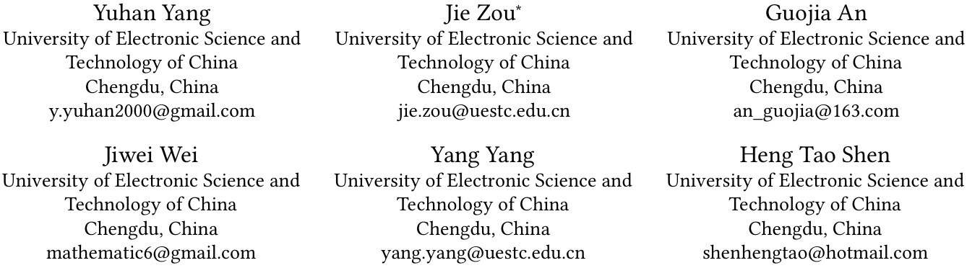





ATAI
Advanced Techniqueof Artificial Intelligence
ATAI
ChongqingUniversity _{AdvancedTechniqueof}
of Technology Artificial Intelligence
Chongqing University of
Technology
Chongqing University ^{ATAI}
_{of Technology} Advanced Techniqueof
Artificial Intelligence
Chongqing University of Technology
Chongqing University of Technology
Unleashing the Potential of Neighbors: Diffusion-based Latent
Neighbor Generation for Session-based Recommendation
Code: https://github.com/yuhanyangyang/DiffSBR/releases
2026.1.14•ChongQing
—— KDD 2026
Reported by Shunan Yin
1

Slide 2

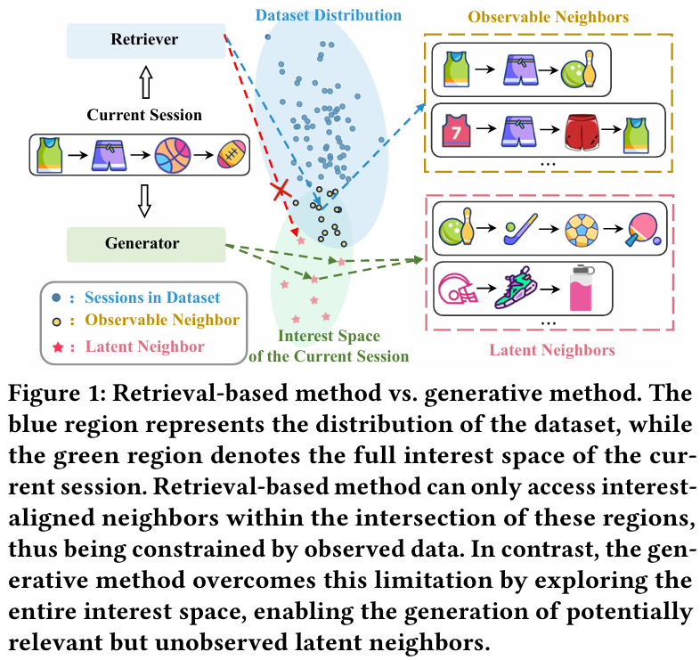
ATAI
AdvancedTechniqueof
Artificial Intelligence
ATAI
ChongqingUniversity _{AdvancedTechniqueof}
of Technology Artificial Intelligence
ChongqingUniversity of Technology
Motivation
1)Existing methods typically rely on observed session data, neglecting latent neighbors - not directly observed but potentially relevant within the interest space.

Slide 3

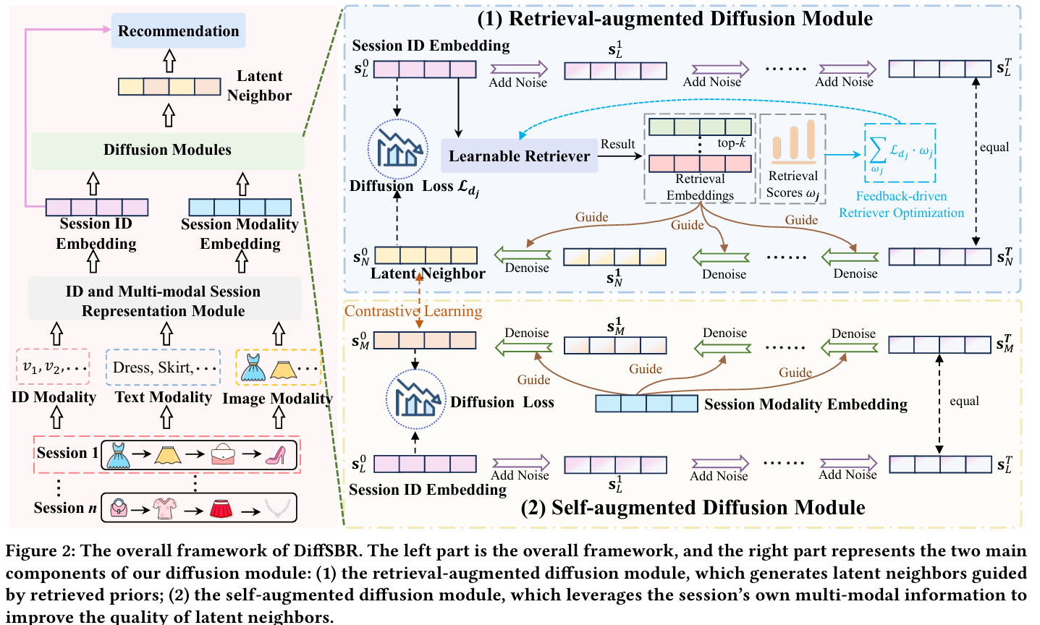
ChongqingUniversity of Technology
ATAI
AdvancedTechniqueof
Artificial Intelligence
ATAI
ChongqingUniversity _{AdvancedTechniqueof}
of Technology Artificial Intelligence
Overview

Slide 4


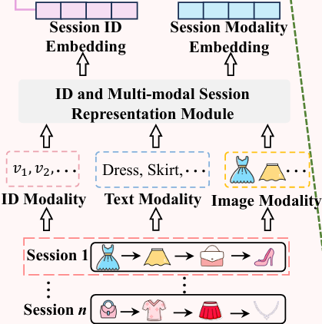




ChongqingUniversity of Technology
Method
ATAI
AdvancedTechniqueof
Artificial Intelligence
ATAI
ChongqingUniversity _{AdvancedTechniqueof}
of Technology Artificial Intelligence

Slide 5
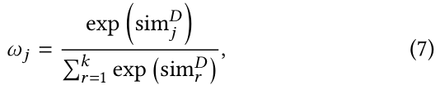
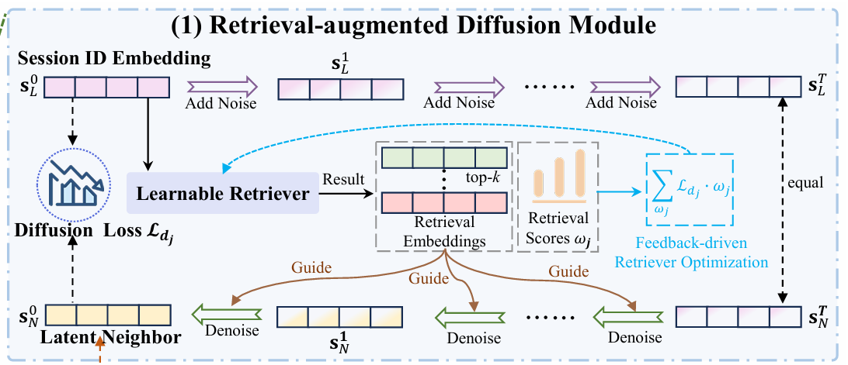





ChongqingUniversity of Technology
Method
ATAI
AdvancedTechniqueof
Artificial Intelligence
ATAI
ChongqingUniversity _{AdvancedTechniqueof}
of Technology Artificial Intelligence

Slide 6
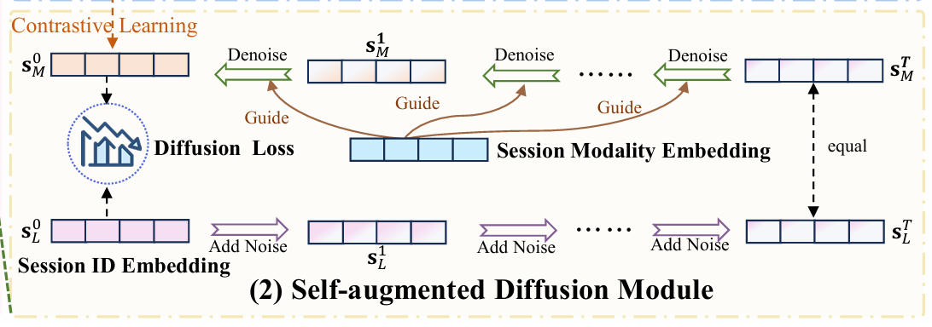

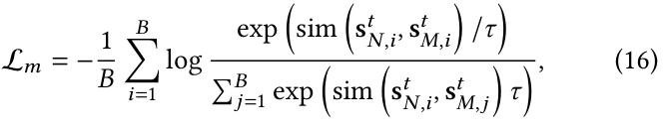
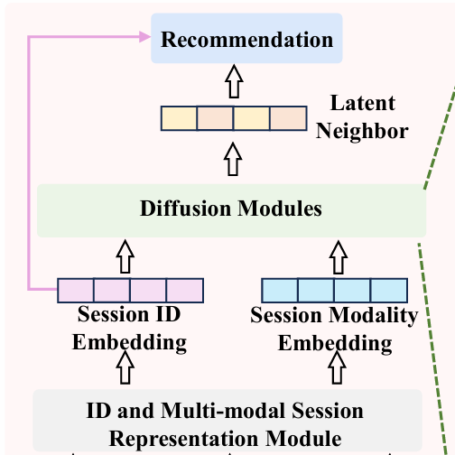


ChongqingUniversity of Technology
Method
ATAI
AdvancedTechniqueof
Artificial Intelligence
ATAI
ChongqingUniversity _{AdvancedTechniqueof}
of Technology Artificial Intelligence

Slide 7

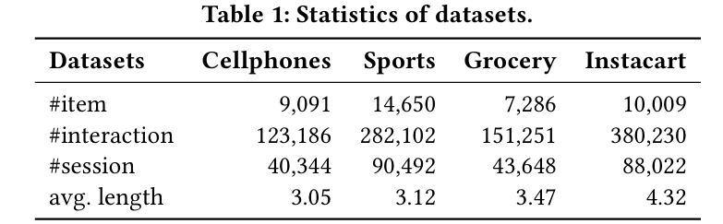
Experiments
ATAI
AdvancedTechniqueof
Artificial Intelligence
ATAI
ChongqingUniversity _{AdvancedTechniqueof}
of Technology Artificial Intelligence
ChongqingUniversity of Technology

Slide 8
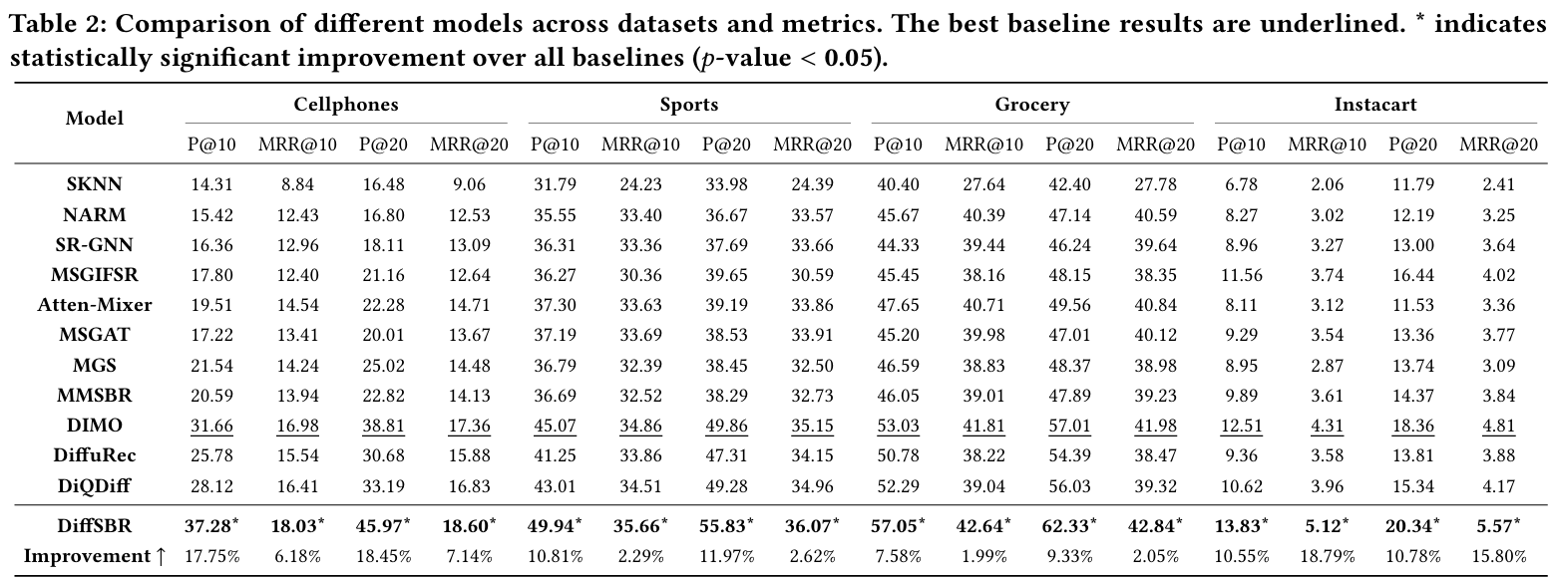
Experiments
ATAI
AdvancedTechniqueof
Artificial Intelligence
ATAI
ChongqingUniversity _{AdvancedTechniqueof}
of Technology Artificial Intelligence
ChongqingUniversity of Technology

Slide 9
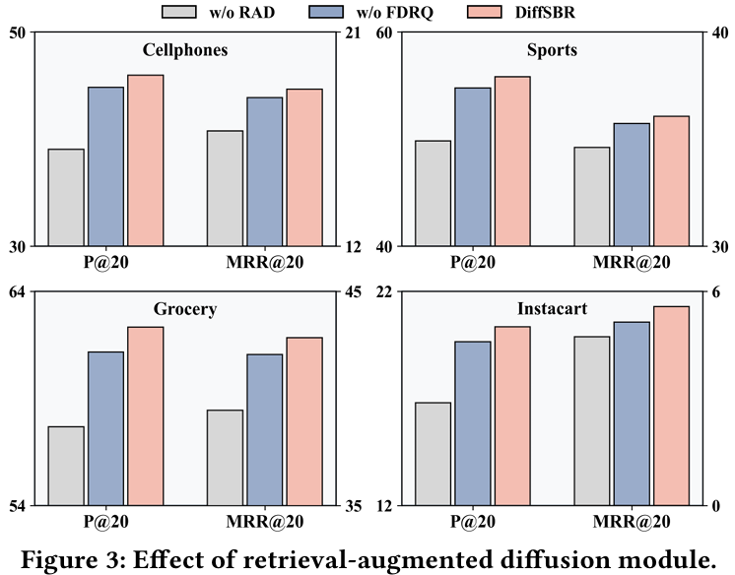
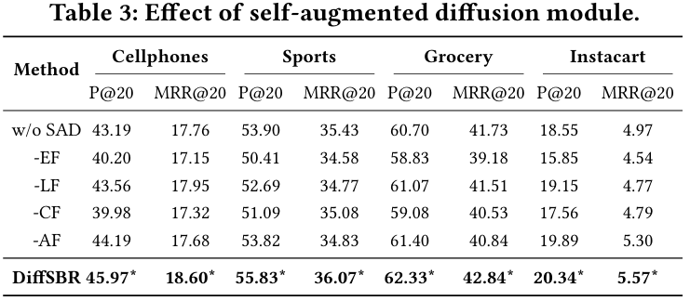
ATAI
AdvancedTechniqueof
Artificial Intelligence
ATAI
ChongqingUniversity _{AdvancedTechniqueof}
of Technology Artificial Intelligence
ChongqingUniversity of Technology
Experiments
Notes:
-SAD：删除自增强扩散模块，这意味着在整个框架中不使用多模态信息，只使用ID
-EF：采用早期融合策略，模态嵌入直接集成到检索增强扩散模块的输入中
-LF：后期融合，在预测阶段结合模态嵌入
-CF：将模态直接合并到检索增强扩散模块的条件中来执行条件融合，然后使用该条件来指导去噪
-AF：保留了自增强扩散模块，但用跨通道注意机制取代对比学习

Slide 10
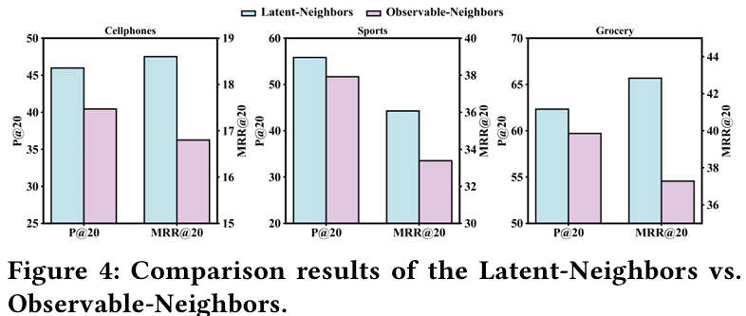
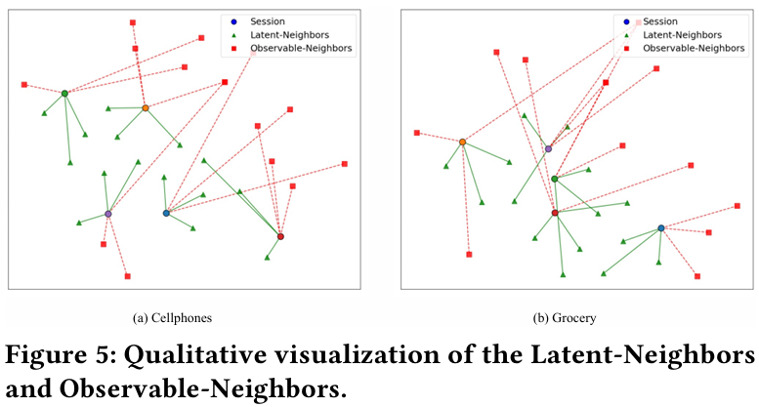
Experiments
ATAI
AdvancedTechniqueof
Artificial Intelligence
ATAI
ChongqingUniversity _{AdvancedTechniqueof}
of Technology Artificial Intelligence
ChongqingUniversity of Technology

Slide 11
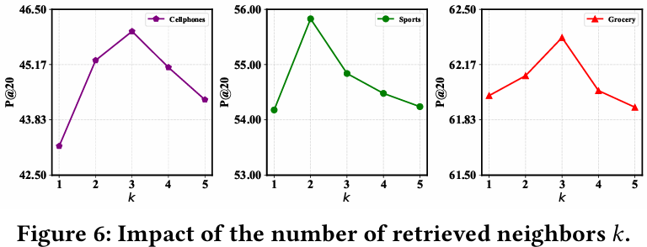
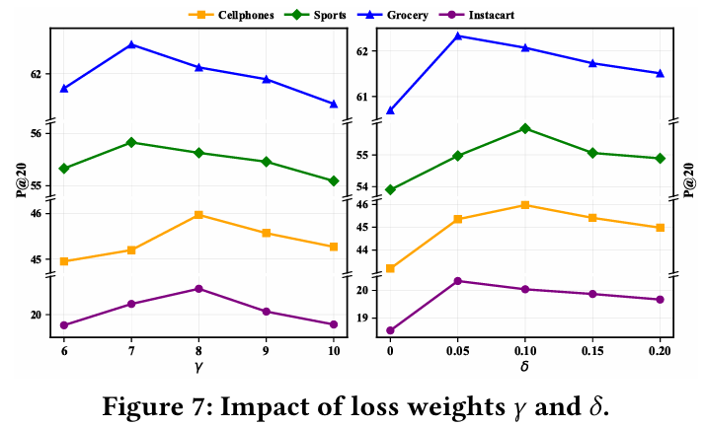
Experiments
ATAI
AdvancedTechniqueof
Artificial Intelligence
ATAI
ChongqingUniversity _{AdvancedTechniqueof}
of Technology Artificial Intelligence
ChongqingUniversity of Technology

Slide 12


ChongqingUniversity of Technology
ATAI
AdvancedTechniqueof
Artificial Intelligence
ATAI
ChongqingUniversity _{AdvancedTechniqueof}
of Technology Artificial Intelligence
Thanks!

